Slide 1
Car Collision Analysis in WA State for 2022
Group 4: Donald Yin, Anas Fathul, Julien Johnson
Notes:
Don

Slide 2
Data Sources
We used two sources of for our data
Primary data set was from Washington State Patrol - Collision Analysis Database
Database stores car collision data submitted by law enforcement officers including level of severity, if there were pedestrians involved, which road did the collision happen etc.
It does not include level of traffic at each collision.
Supplementary data was from Washington State Department of Transportation - Traffic Counts (AADT) for 2022
For each state road and on parts of each state road, it records the Annual Average Daily Traffic (i.e. the level of traffic), as well as the milepost
Uploaded them online to have access to them
Notes:
Don

Slide 3
Research Questions
Are there specific areas (county, city, or specific road) that are more prone to collision? Are these characterized by fewer or less severe collisions?
What are the key predictors contributing to road collisions in Washington state at various scales (County, City level, weather, etc.)?
Can we develop a model to predict high-risk scenarios or high-risk drivers based on historical data and define scenarios that are more likely to involve severe collisions?
Notes:
Don

Slide 4
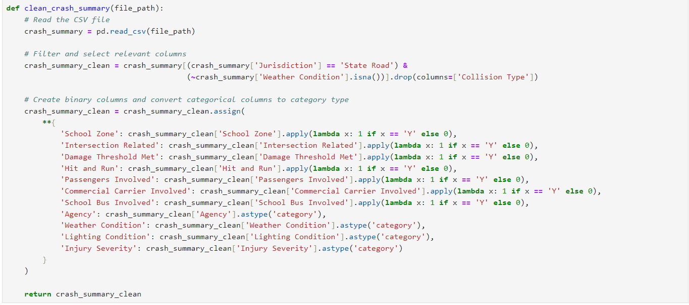
Data Cleaning
We used the following function to clean the data:
We need cleaned the data for the collisions (primarily changes a lot of variables into 1s and 0s.
Notes:
Anas
So we definitely will need to do some cleaning on the data. After some exploration, we will drop some variables that does not have any values through all data points. Then, we will check across this all columns to classify what kind of data type.

Slide 5
Data Structure
Binary (Y,N):
School Zone
Intersection Related
Damage Threshold Met
Hit and Run
Passengers Involved
Commercial Carrier Involved
School Bus Involved
Numerical
Motor Vehicles Involved
Pedestrian Involved
Pedal cyclists Involved
Factor
Agency 4
Weather Condition 11
Lighting Condition 9
Injury Severity 5
Date/time
Collision Date
We end up with 43422 data points with 27 features.
We will use Injury Severity (5 level) to assess the severity of a collision which consists of:
Low Severity Collision
Unknown Injury Collision
No Injury Collision
Minor Injury Collision
High Severity Collision
Serious Injury Collision
Fatal Collision
Notes:
Anas

Slide 6
Dataset Creation
We combined those data sets into one
We looked at ONLY the data on collision for state roads and only during 2022
To correspond with the 2022 Traffic Count Data
Found the State Road each collision was on using regex
Checked if the gotten State Road is a valid state road by checking the state roads on the Traffic Counts data.
For each Collision
if it has a milepost, we would get the AADT of the nearest mile post nearest to it
If it didn’t, would instead get the median AADT of the state road.
Removed all collisions that did not have an AADT value.
Removed 1184 Data points out of 44606 Data points (roughly 2.5% of our data)
Notes:
Julien

Slide 7
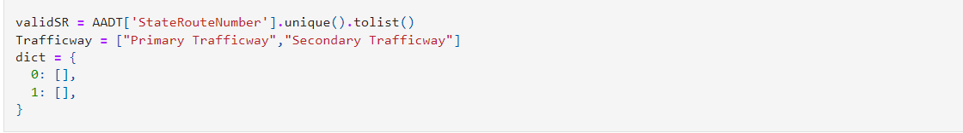
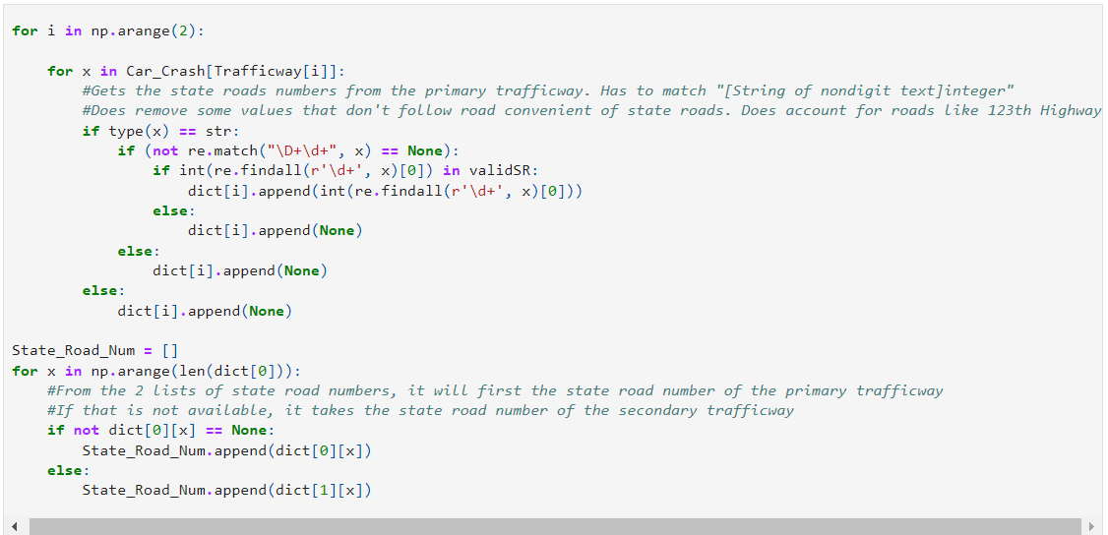
Notes:
Julien

Slide 8
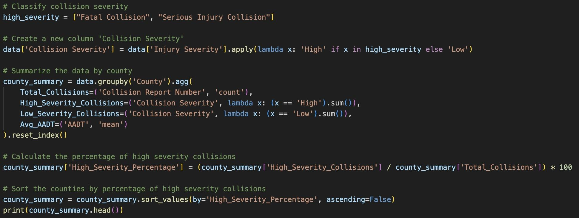
Per County Analysis
Notes:
Don

Slide 9
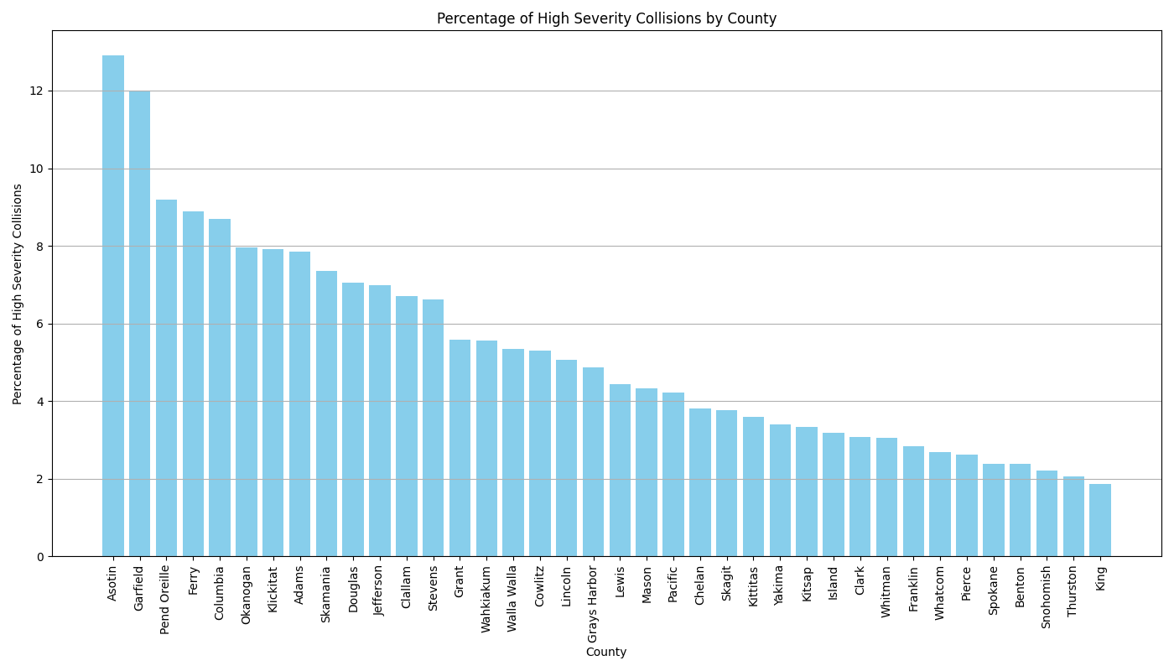
Notes:
Don

Slide 10
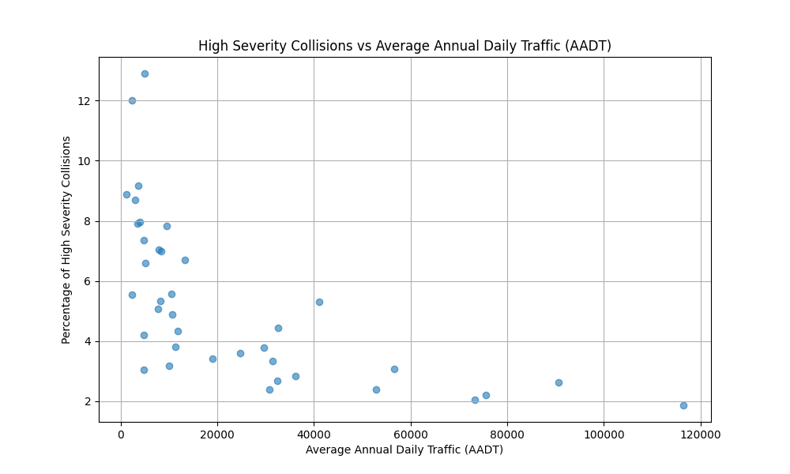
Notes:
Don

Slide 11
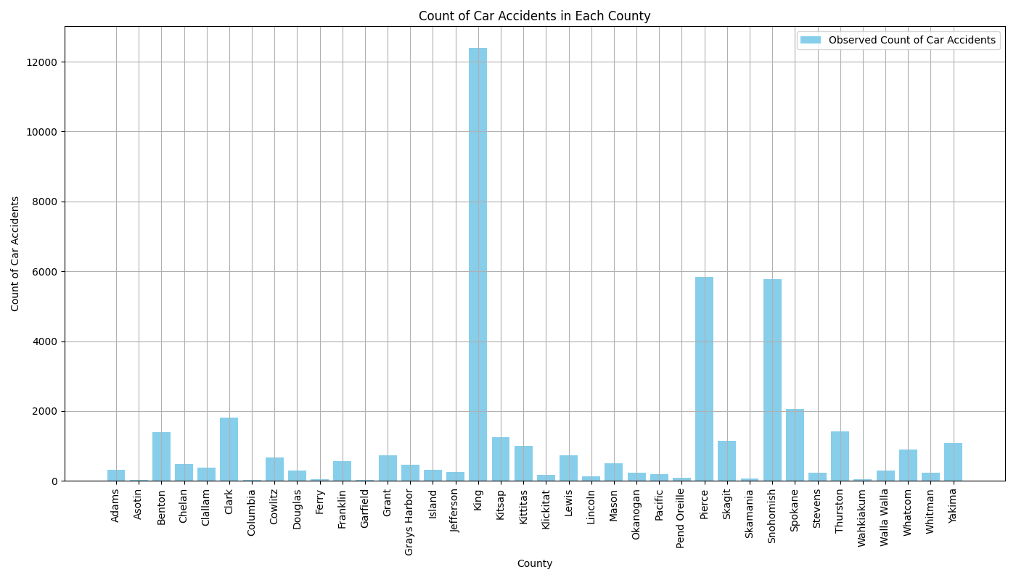
Notes:
Don

Slide 12
Model Prediction
To predict the severity level of certain collisions we used a Naive Bayesian to classify each data point.
The rationale of using this is that the variables (like weather condition, state road number, AADT, etc.) are assumed to be independent since they seemingly don’t affect one another (a key assumption for Naive Bayesian).
Uses probability to classify the data, classifying the data on which probability is the greatest.
Notes:
Julien

Slide 13
Model Prediction
Classified on 1 of 4 severity levels (No injury, minor injury, serious injury, and fatal) (dropping any data points with unknown injury level)
It would consider the following variables
State Road Number, Milepost, Intersection Related, Weather Condition, Lighting Condition, AADT, and whether the following were involved:
Motor Vehicles
Passengers
Commercial Carrier
School Bus
Pedestrians
Pedal cyclists
Notes:
Julien

Slide 14
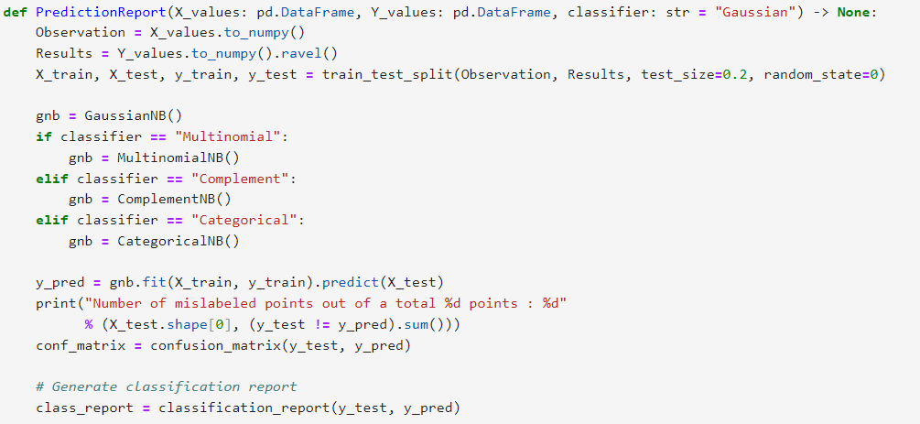
Notes:
Julien

Slide 15
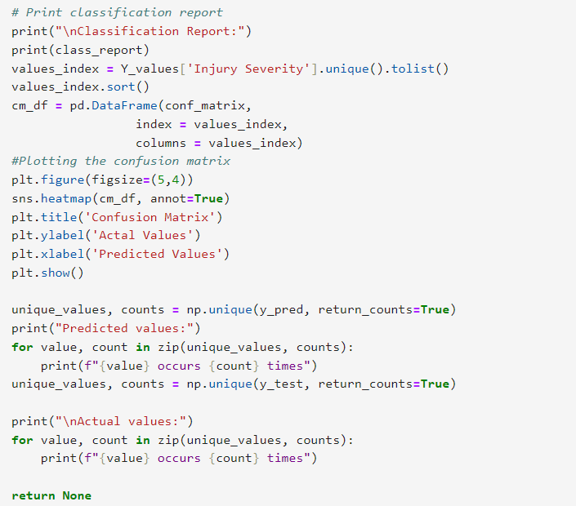
Notes:
Julien

Slide 16
Prediction
1st we predicted using the Categorical Naive Bayesian:
It is described as the following: “The categorical Naive Bayes classifier is suitable for classification with discrete features that are categorically distributed. The categories of each feature are drawn from a categorical distribution.”
Our test size was 20% of the data

Slide 17
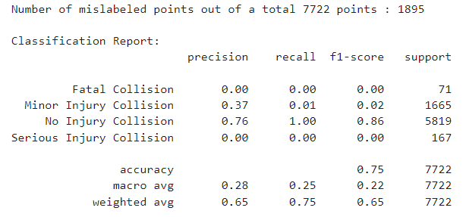
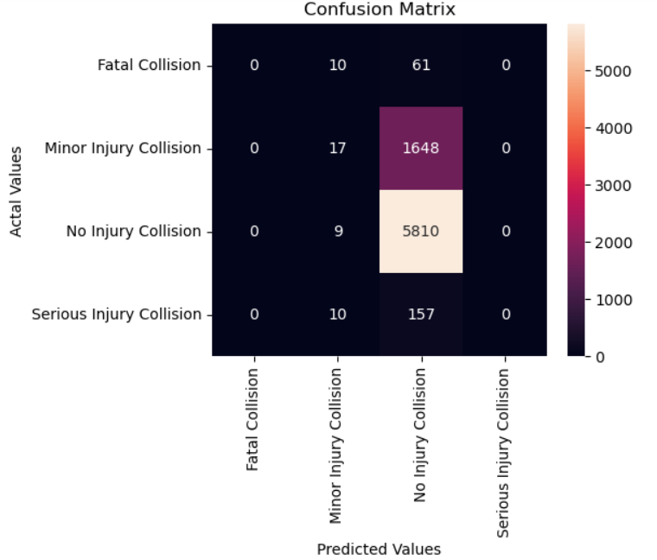
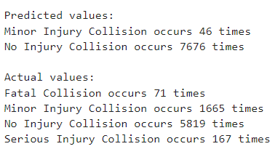
Notes:
Julien

Slide 18
Prediction
As you can see it only really predicts 1 of two values as.
It has 100% recall for No Injury but because it was guessing no injury since its the majority of our data.
While it does “well” in term of accuracy, it is presumably being overfit with the larger amount of data primarily consisting of no injury collisions.
We did a second prediction with using Complement Naive Bayesian Classification
“ CNB is an adaptation of the standard multinomial naive Bayes (MNB) algorithm that is particularly suited for imbalanced data sets.”
Notes:
Julien

Slide 19
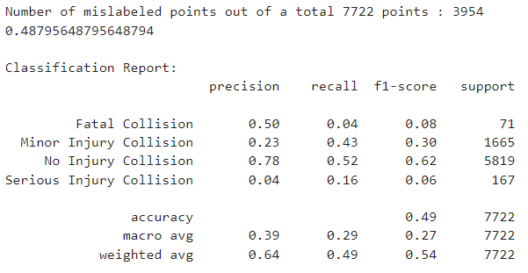
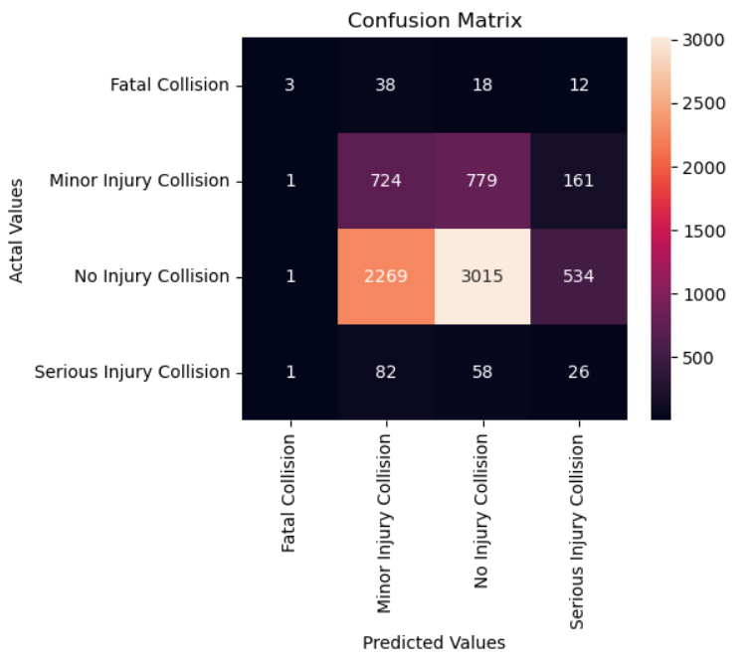
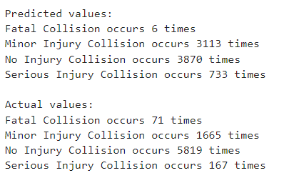
Notes:
Julien

Slide 20
Model Evaluation
1st Model
While the first prediction model does better, it generally cannot seem to predict much other collisions besides No Injury.
The second does worse but can actually predict to some extent other collisions and generally has higher precision.
We would suggest that the second model is preferred despite lower accuracy because of it this and it seemingly has a reduced case of overfitting.
2nd Model
Notes:
Julien

Slide 21
Model Evaluation
As you can see it is possible to predict the severity of car crash using naive bayesian. However it is subject to the potential overfitting from the lots of data of no injury. Complement Naive Bayesian seems to address this and give a more versatile predictor that while is less accurate, can be more precise for all collision types.
Notes:
Julien

Slide 22
Classification by Random Forest
We aim to identify the key predictors contributing to road collisions in Washington state.
We will use the Random Forest model to find the features importance across predictors:
﻿﻿An ensemble classifier that uses multiple decision tree models.
It improves prediction accuracy and control overfitting by averaging multiple decision trees.
Can be used for classification or Regression.
We choose Random Forest as it can handle large datasets with high dimensionality, robust against overfitting, and provide features importance measures.
Data Preparation -> Features Considered -> Data Splitting -> Train the model -> 5 K-fold Cross Validation for tuning parameter -> Test Model
Tuning parameter:
n_estimator : number of decisions trees
max_depth: depth of decision trees
Whole dataset is use instead of bootstrap
Notes:
Anas
Auprc: 0.75

Slide 23
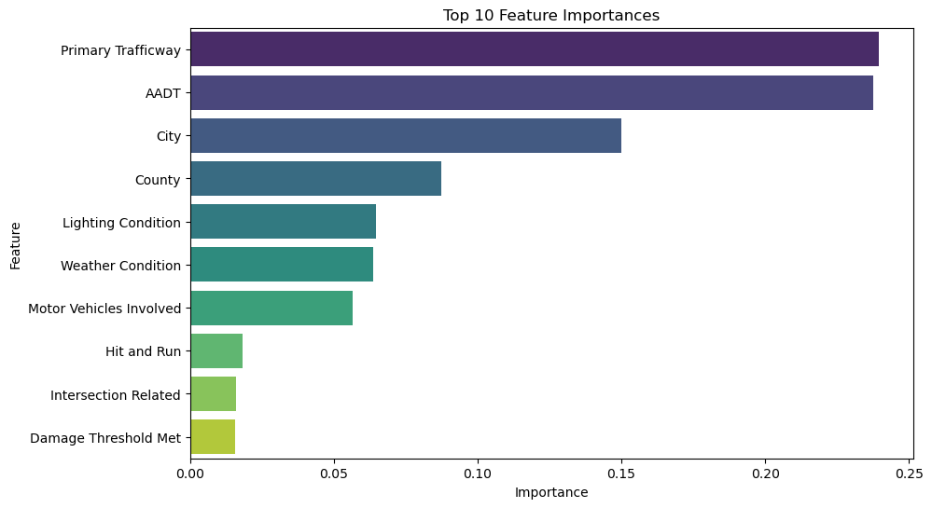
Random Forest Result
Notes:
Anas:
R-squared
MSE: AUPRC: 0.73

Slide 24
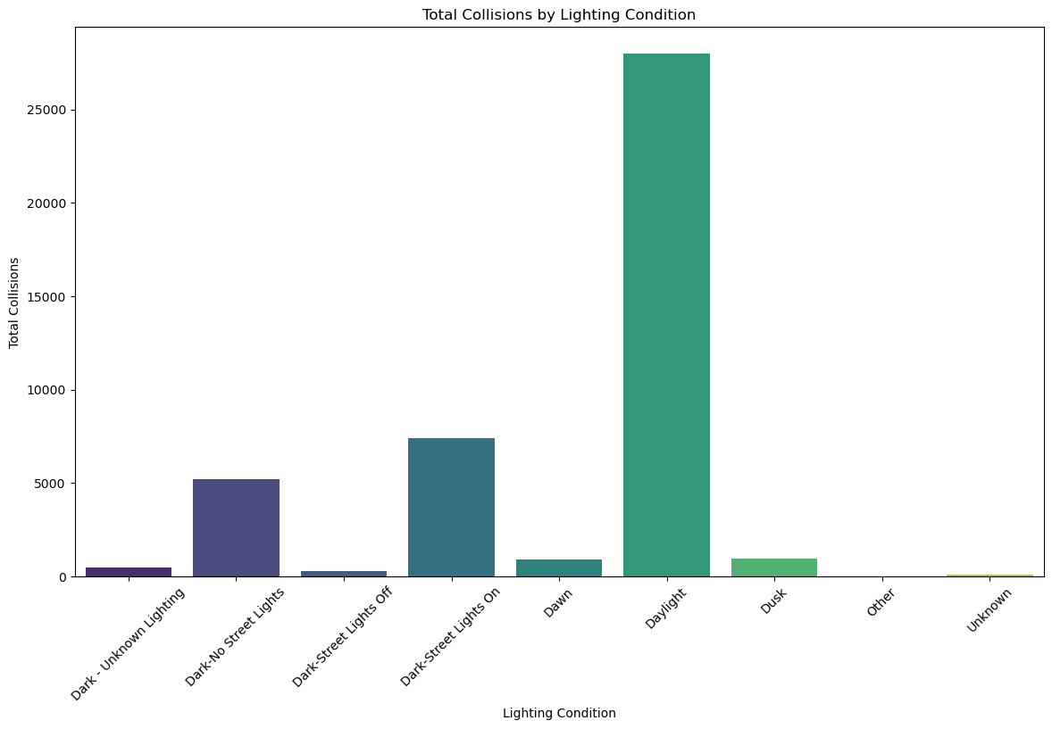
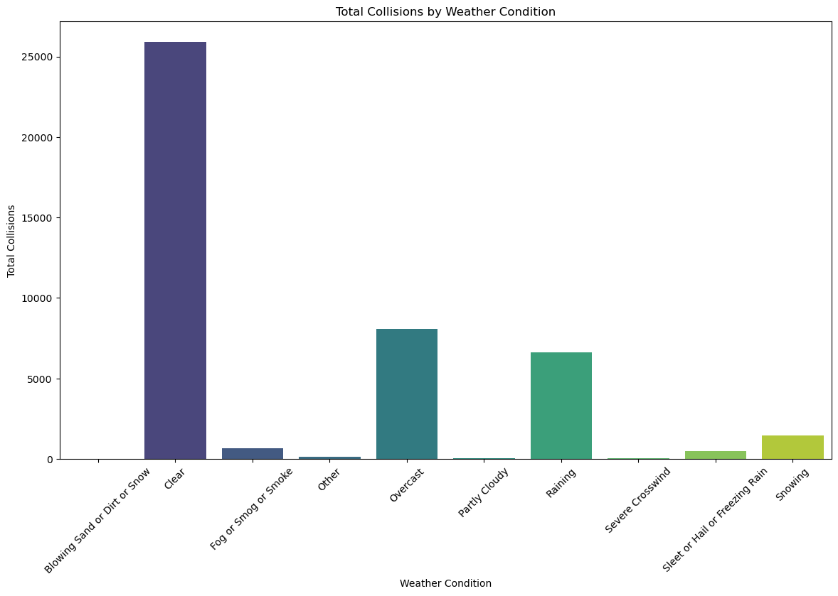
Lighting & Weather Conditions

Slide 25
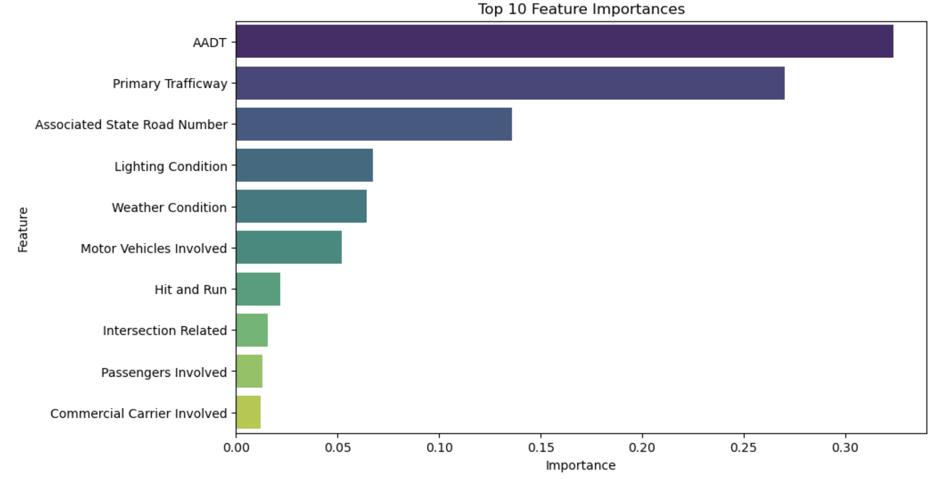
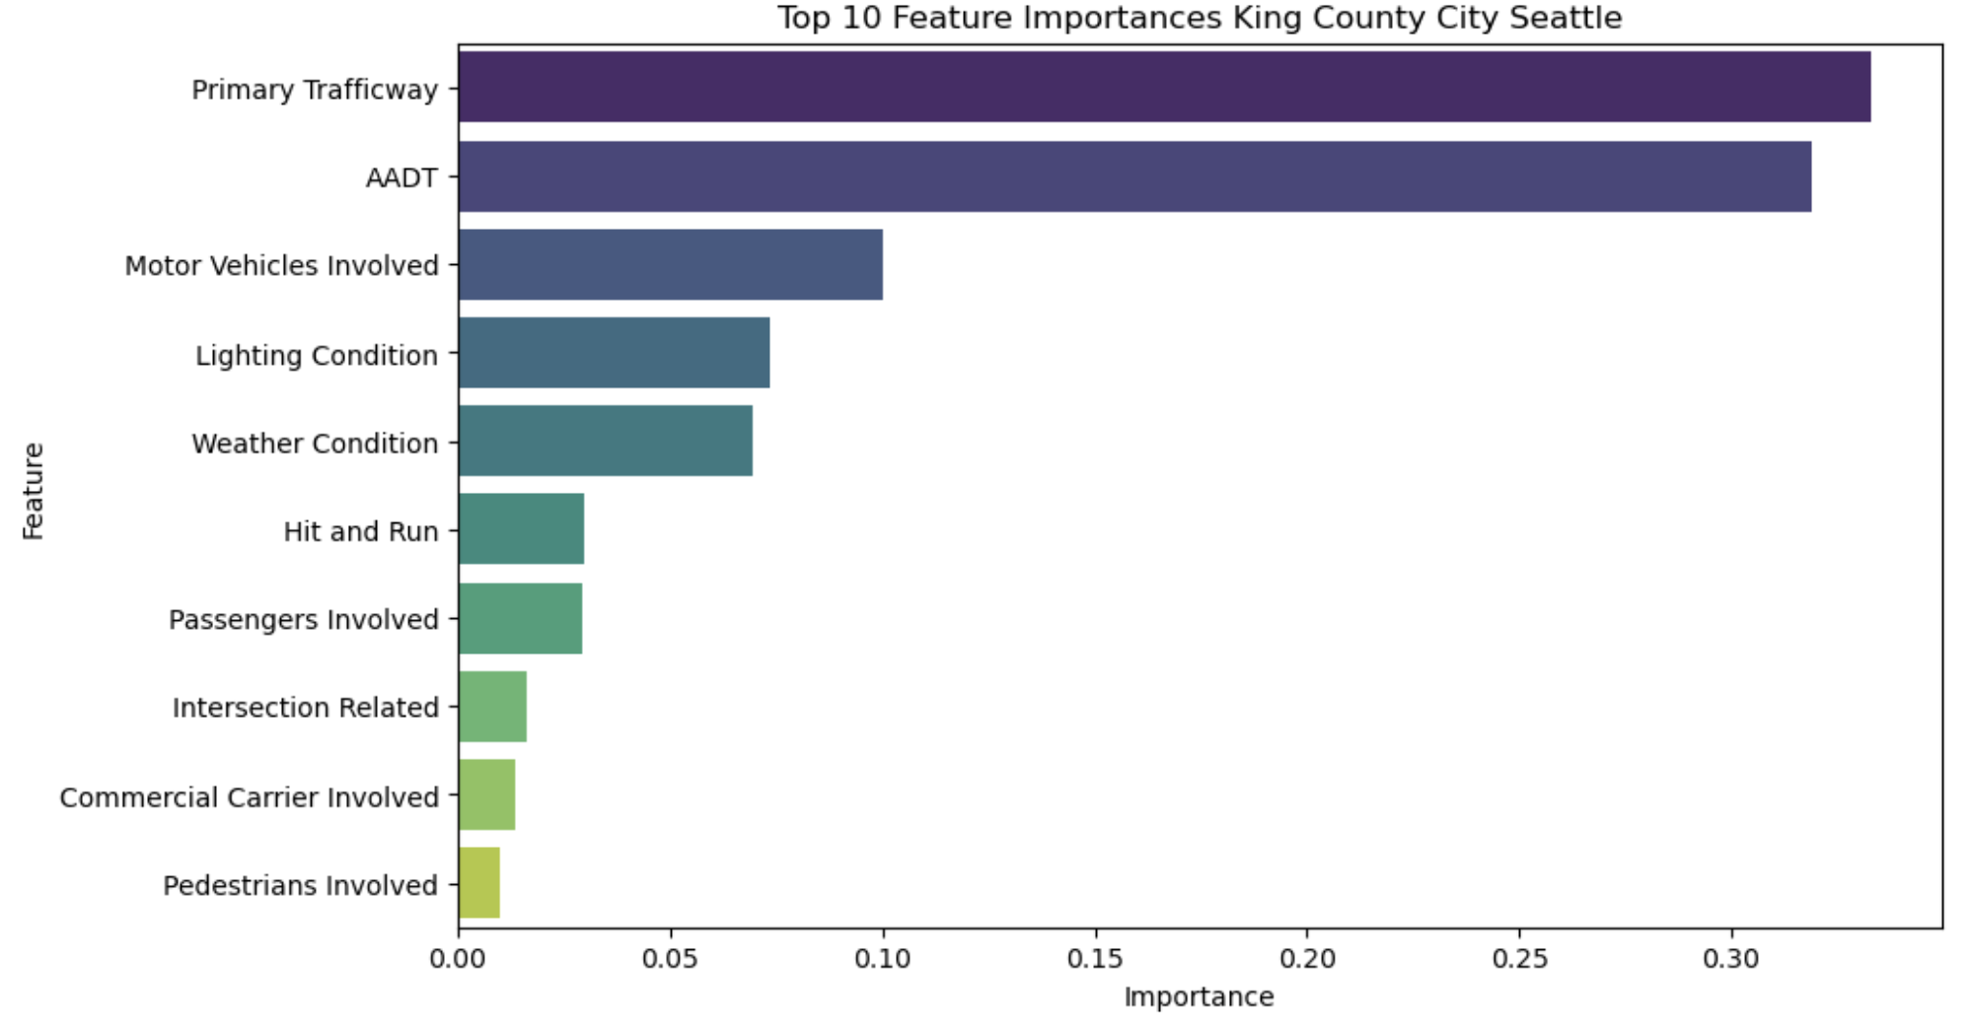
Problems
Too much data points from higher AADT trafficways/counties
Led to skewed results because high traffic regions became the primary feature of collisions.
Tried focusing in on the city level but came out with the same results

Slide 26
Solution
Ran a stratified random sample by interstate road.
For each interstate road that had >100 reported accidents, we randomly sampled 100.
This allowed us to have a more standard spread of collision data across major traffic regions.
Notes:
Anas

Slide 27
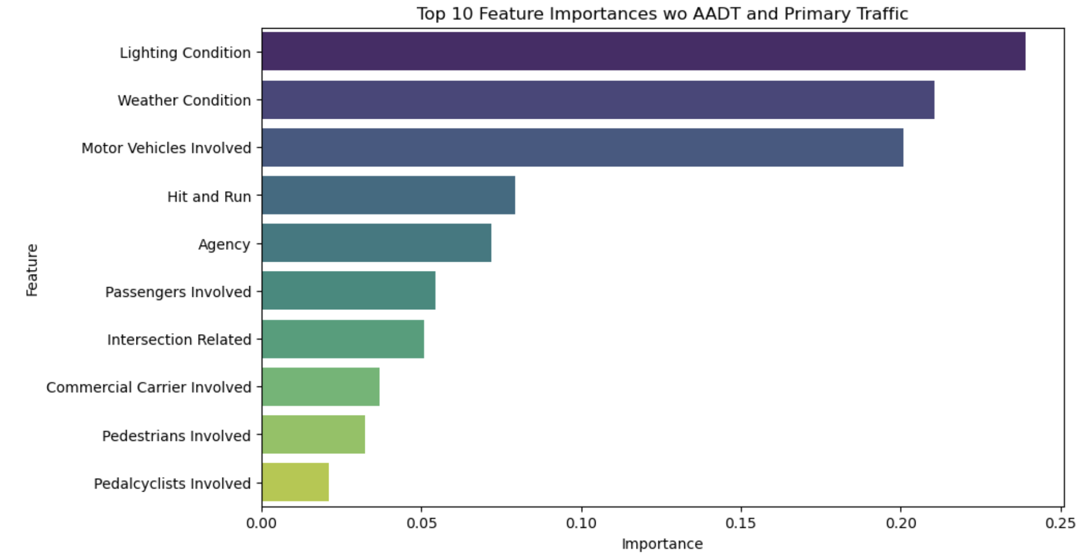
Notes:
Anas

Slide 28
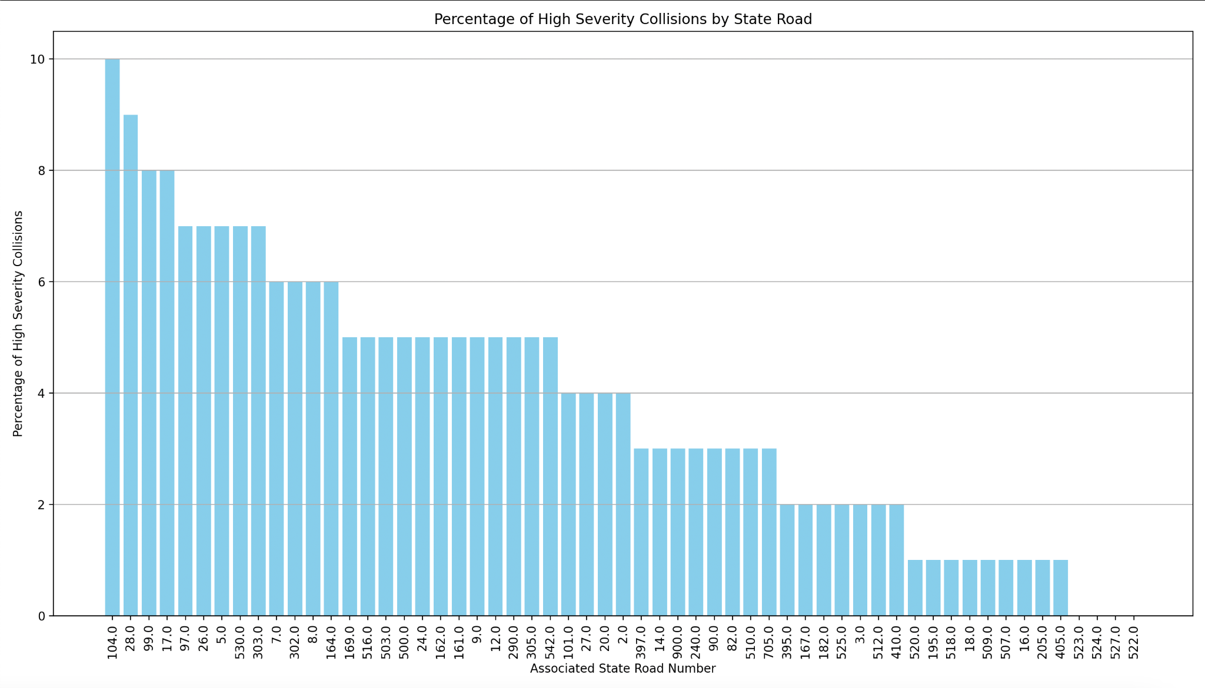

Slide 29
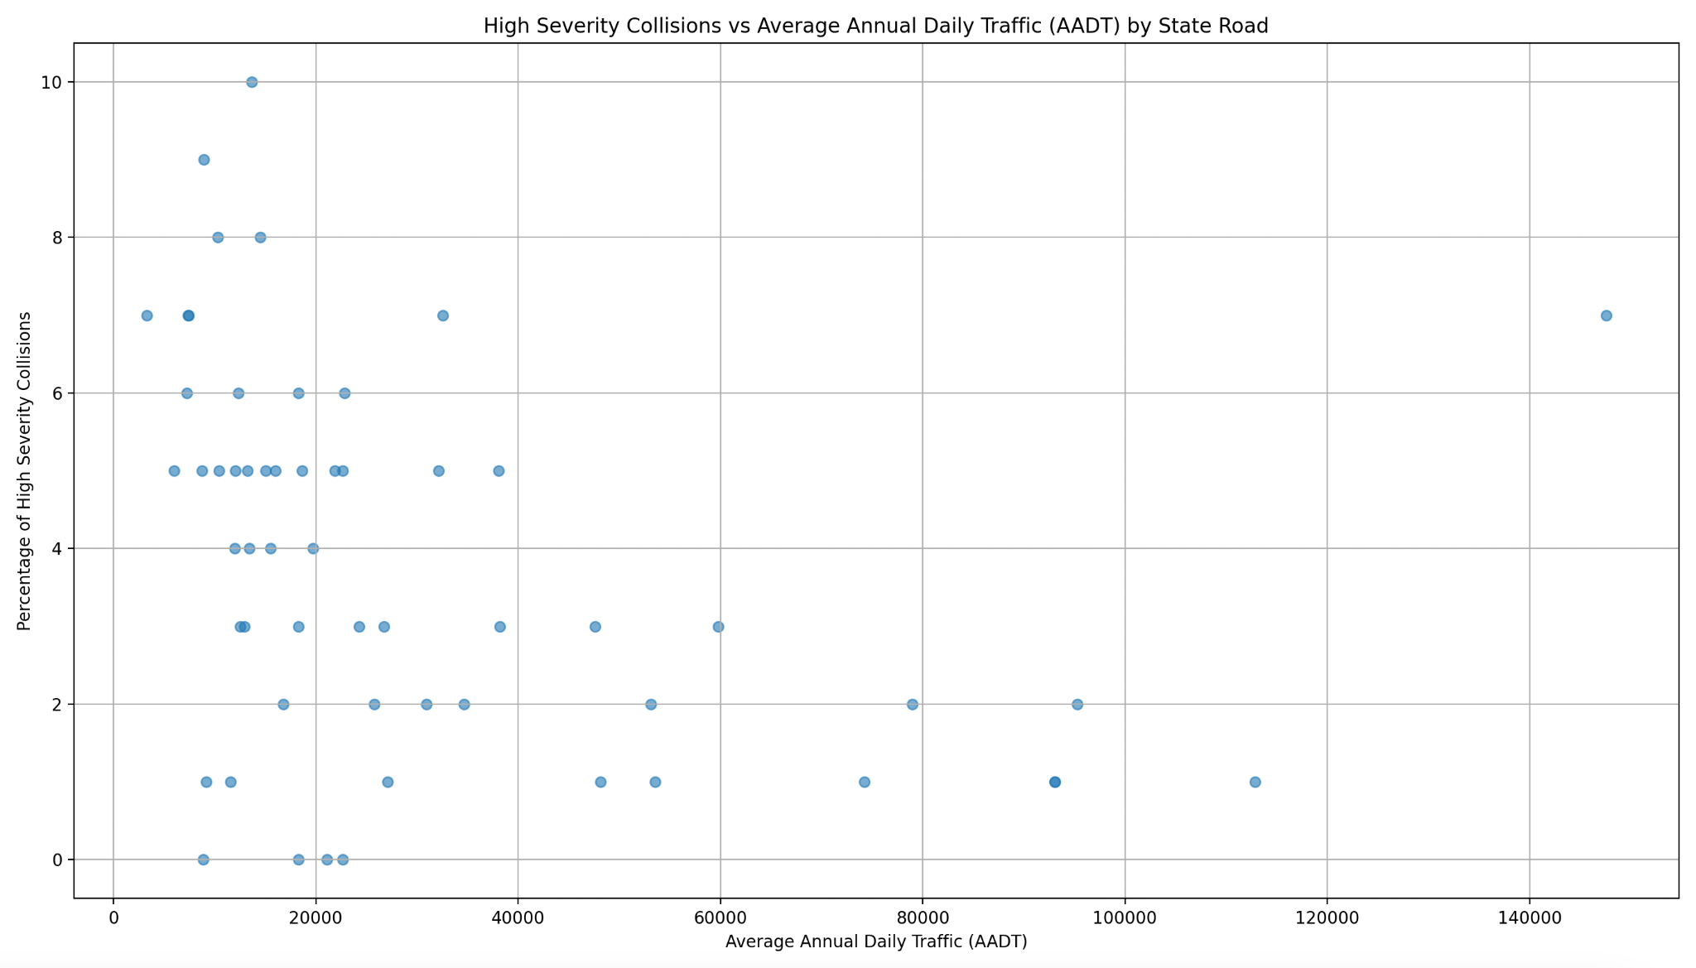

Slide 30
LS on the Variables and the Effects
To get an initial idea of the effects of each variable, we set up an Homoskedastic Robust Least Squares model to regress on the Injury Severity (Low or High) (0,1 respectively) by:
School Zone (was it at a school zone)
Intersection Related (was it at an intersection)
Damage Threshold Met (whether the collision cost more than $1,000),
whether it was a Hit and Run,
Number of Motor Vehicles Involved,
Whether if the following were involved (0,1) for each
Passengers
Commercial Carrier
School Bus
Pedestrians
Pedalcyclists
AADT (traffic level)
Dummy Variables for each Lighting Condition, Weather Condition, and County

Slide 31
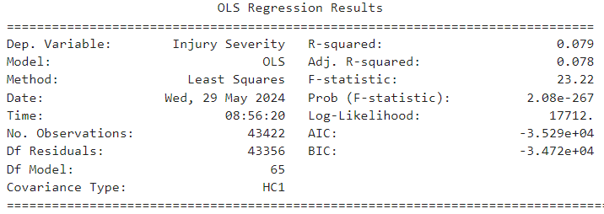
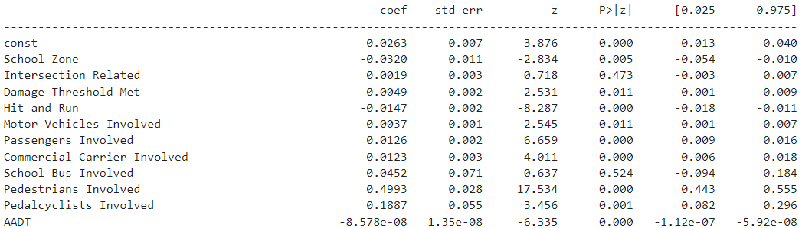

Slide 32
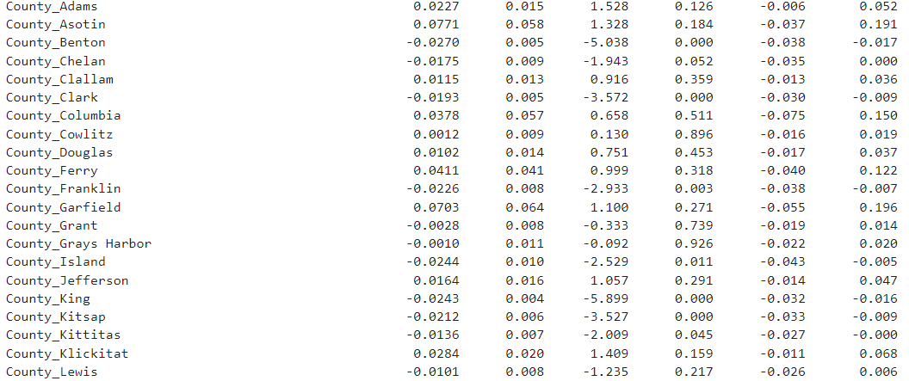

Slide 33
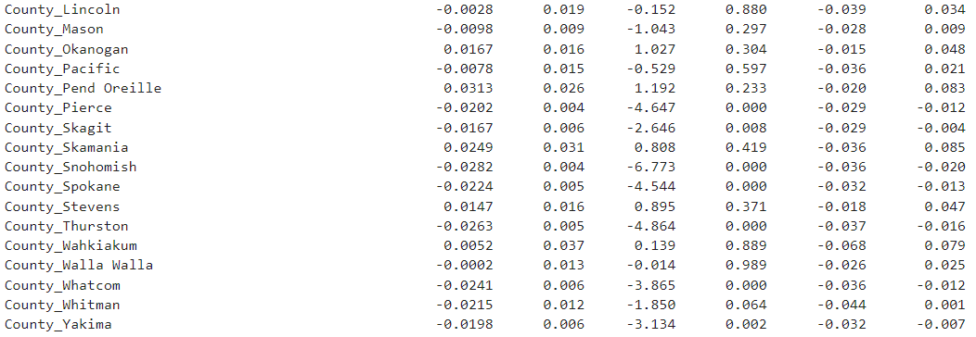

Slide 34
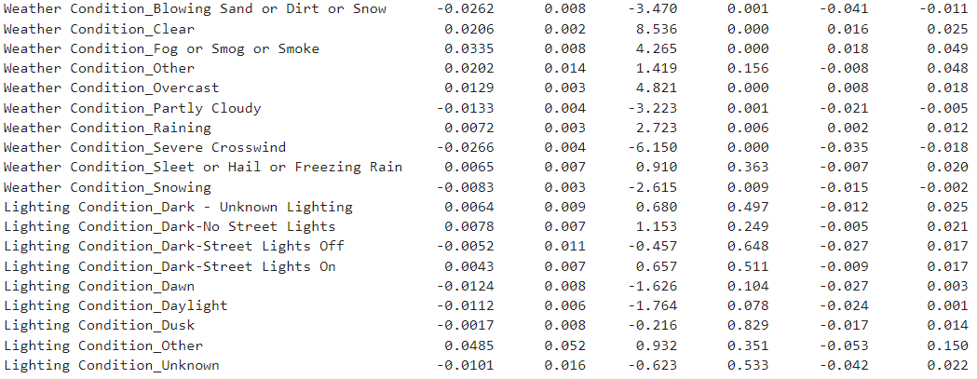

Slide 35
Immediate Analysis
Of the conditions that were most significant
Pedestrian and Pedalcyclist involvement were the greatest indicators of a collision being severe
The more the motor vehicles there were, the more dangerous the accident.
AADT was negatively correlated accident severity with higher AADT leading to less severe accidents
Most weather conditions were significant
Generally light did seem to reduce accident severity
All the counties that were significant had were negatively correlated so less likely to have a severe injury.
Might have to do with the large sample of no injury data

Slide 36
LS with Traffic Fixed
We noticed that a large number of collisions had the same AADT value of 5400 (about 3922 counts which is the most of any AADT level).
To see the effects of other conditions without being influenced by the traffic level, we look at only the collisions with the AADT value of 5400 and did a linear regression on the Injury Severity (Low or High) with the same factors (excluding AADT) value

Slide 37
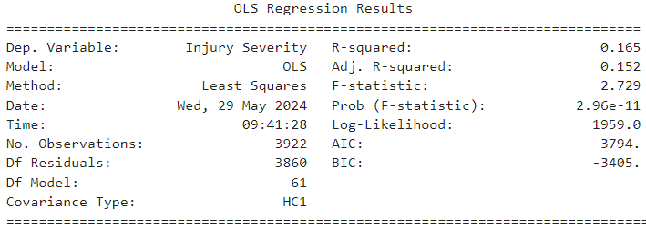
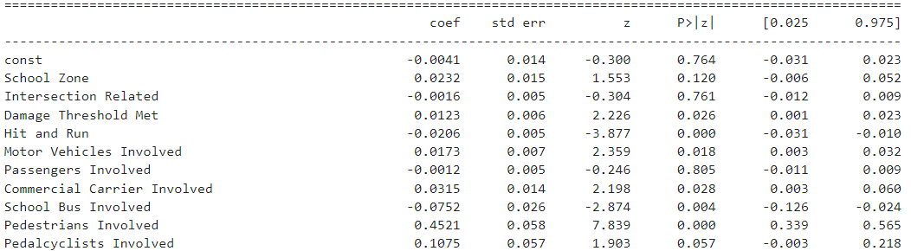

Slide 38
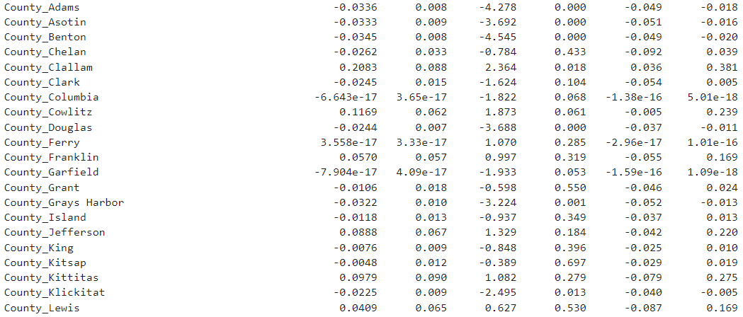

Slide 39
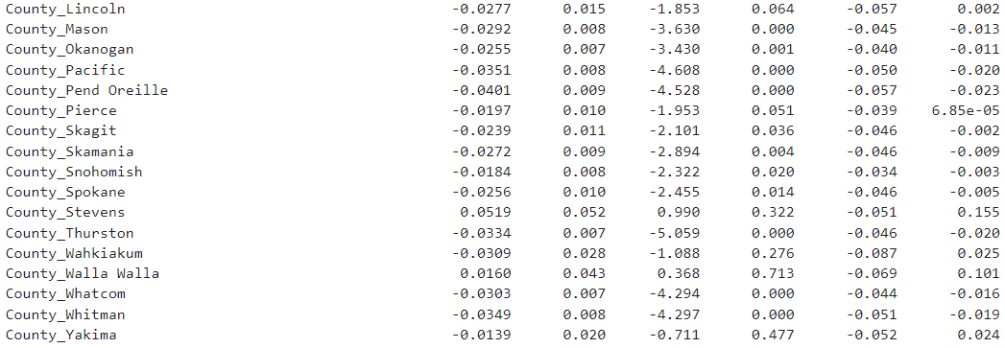

Slide 40
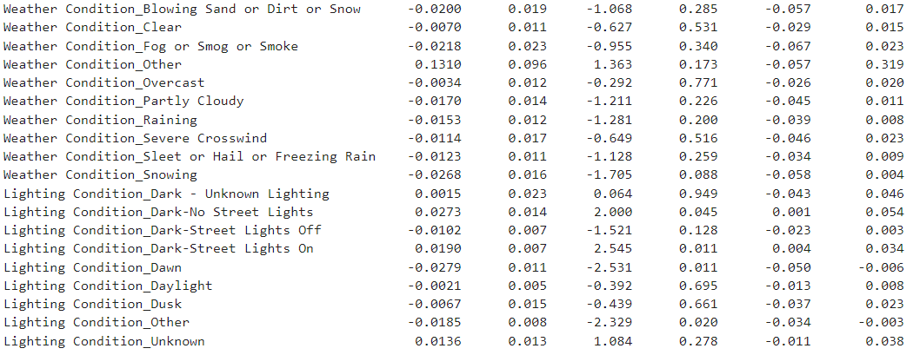

Slide 41
Observations holding AADT constant
Pedestrians and Pedalcyclist involvement generally lead to more severe accidents
Passenger involvement is now negative and not significant
More motor vehicles lead to more severe accidents
Now lighting conditions seem to be far more significant than before
Weather conditions are less significant.
Most significant counties are negatively correlated with accidents (save for Clallam and Cowlitz counties which are positive)

Slide 42
Conclusion
Inconclusive results on county level due to higher traffic in specific regions
Random sampling on state road level shows higher severity at lower AADT levels and vice versa
Specific roads do show higher levels of severity
Key predictors of car accidents:
AADT and Primary Trafficway w/o sampling due to large numbers
Lighting conditions, weather conditions, and other motor vehicles involved are significant to car accidents
It is possible to develop a predictive model however:
It is prone to overfitting due to large amounts of low severity injury
An alternative can be developed with less accuracy but it is able to predict other types of collisions albeit with low recall.

Slide 43
Thank you so much! Questions?

Slide 44
Appendix
We can run this analysis by running this code which will generate the visualization and report for this data:
python main.py

